Slide 1
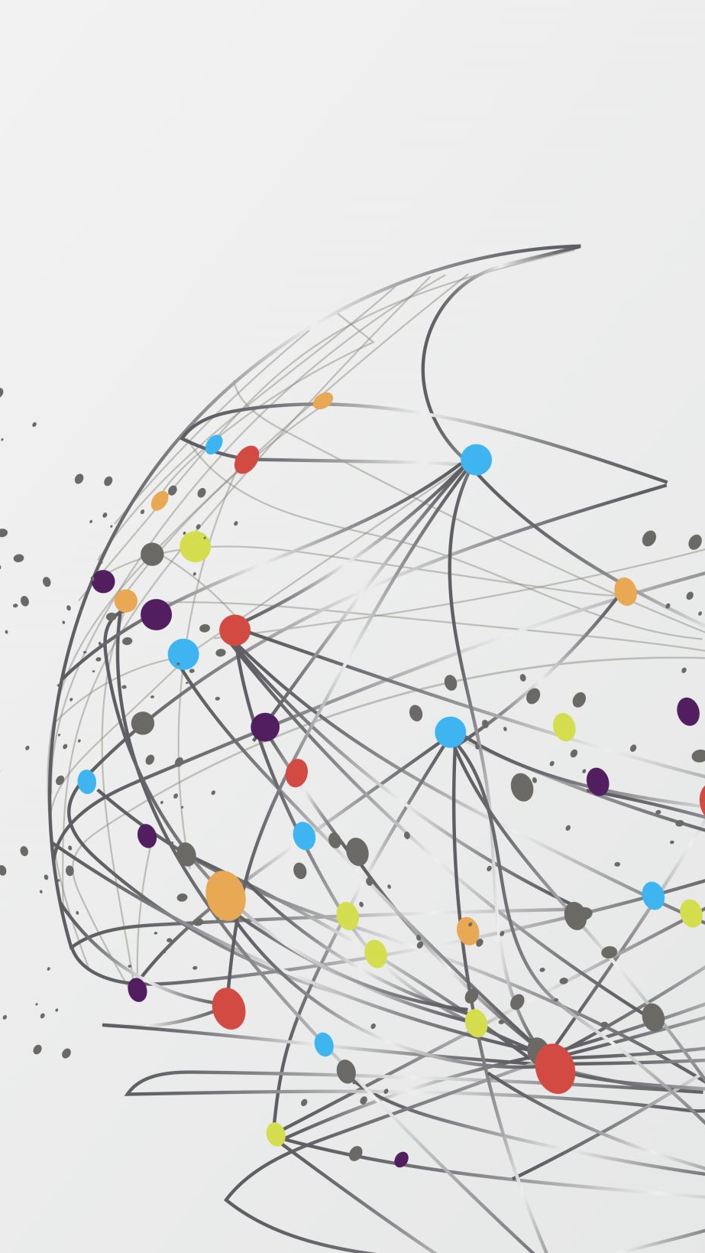
MINOR PROJECT
S SEETHALAKSHMI [RA1811004040001]
M RADHIKA [RA1811004040019]
ECE-A, IV YEAR

Slide 2
ANALYSIS AND PREDICTION OF MARINE LITTER CONTRIBUTION BY DIFFERENT COUNTRIES

Slide 3
ABSTRACT
Plastic is a synthetic organic polymer made from petroleum with properties ideally suited for a wide variety of applications. Over 300 million tons of plastic are produced every year.
At least 8 million tons of plastic end up in our oceans every year. Floating plastic debris are currently the most abundant items of marine litter. Waste plastic makes up 80% of all marine debris from surface waters to deep-sea sediments.
Plastic has been detected on shorelines of all the continents, with more plastic materials found near popular tourist destinations and densely populated areas.
Marine species ingest or are entangled by plastic debris, which causes severe injuries and deaths. Plastic pollution threatens food safety and quality, human health, coastal tourism, and contributes to climate change.

Slide 4
It is really important to analyse the contribution of marine litter by different countries during various years.
Firstly, it is necessary to know the rivers that get littered the most, eventually resulting in ocean pollution as the rivers reach them.
Analysing the datasets that inform the degree of plastic litter in various rivers from different countries would help in visualising the contribution of every country taken into account, importantly in visualising which country contributes the most.
After visualising data from various years , predictions can be made on future contributions by these countries.
Different data visualization and machine learning techniques can be used for this purpose.

Slide 5
SMART TROLLEY USING RFID AND ARDUINO NANO

Slide 6
ABSTRACT
Waiting in a queue for payment in shopping malls and other places is very tiring and time consuming, especially during the billing process.
For this purpose, a smart shopping cart with an automatic billing system can be built that not only reduces the waiting time but also makes the process very smooth and easy.
We use RFID readers with Arduino to build the Smart Shopping Cart project.
When the power ON switch is pressed, the system is initialized, and the cart and the shopper’s smartphone are synchronized.

Slide 7
When an item is selected by the shopper, the RFID reader is used to first scan the product, which is then placed into the cart. During the scanning, the product ID is generated by the RFID.
Comparison of the generated product ID is made with the database on the server. If a match is identified, then the cost and name of the matching product is displayed by the mobile application installed on the smartphone.
By using this application, the products are added to the total bill, which is calculated and displayed on the smartphone.
An option to delete is also included, in the case that the shopper wants to remove any product after adding it.
When shopping has been completed, the shopper touches the FINISH button and the total bill for the payment is displayed on LCD and mobile application.

Slide 8
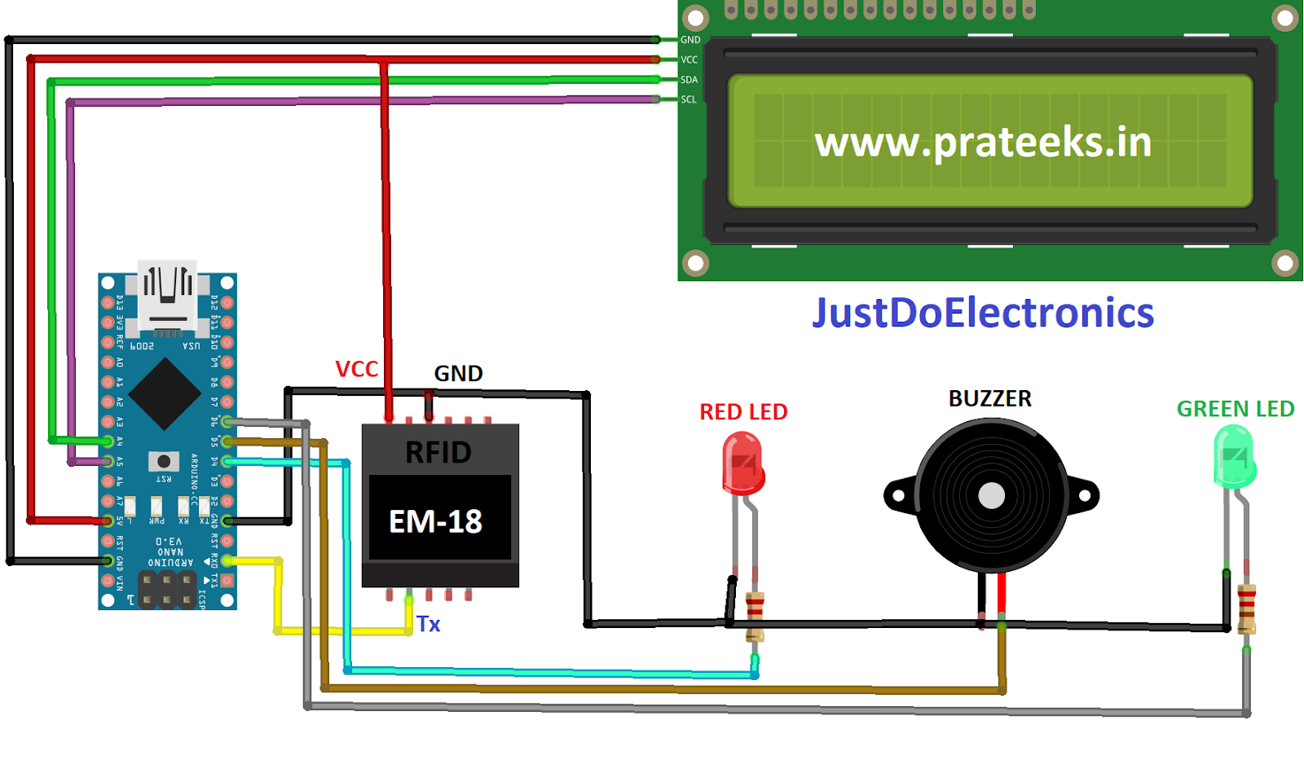
Components used:
Arduino Nano R3
EM18 RFID Reader
Buzzer
LCD Display
Approximate total cost – Rs. 1850

Slide 9
ARDUINO MUSICAL INSTRUMENT -THEREMIN

Slide 10
ABSTRACT
The Theremin is an electronic musical instrument controlled without physical contact by the thereminist (performer).
In this project we build an instrument (theremin) that produces tones or sounds based on the light that falls on the surface of the Photoresistor.
By moving your hand over the photoresistor, the intensity of light falling on it, changes, and that changes the pitch.
The measured brightness is assigned a minimum and a maximum tone frequency (pitchMin and pitchMax). However, these values can still be changed during runtime with two trimmer potentiometers.

Slide 11
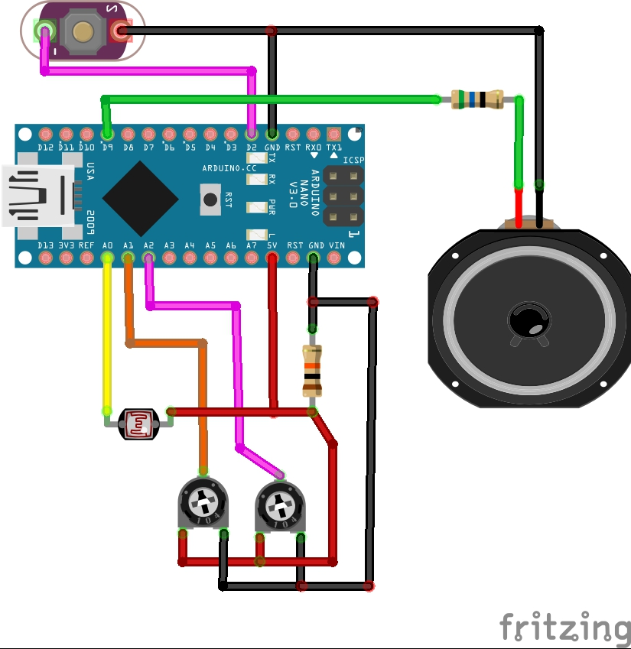
Components used:
Arduino Nano R3 microcontroller
Photoresistor
Speaker: 0.25W, 8 ohms
Single Turn Potentiometers(2)- 100k ohms
Two resistors 10k ohm
Pushbutton Switch
Approximate total cost – Rs. 1800

Slide 12
REFERENCES:
[1] https://www.iucn.org, https://www.kaggle.com/datasets
[2] "Supermarket Shopping System using RFID as the IoT Application" - Sakorn Mekruksavanich, Department of Computer Engineering School of Information and Communication Technology ,University of Phayao, Phayao, Thailand.
[3] https://www.hackster.io/

Slide 13
THANK YOU

